Slide 1

THE HAPTIC INTERFACE SYSTEM FOR THE DISABLED INDIVIDUALS
GUIDE:G.SWATHI MAM
D.RAMU 247R1A0579
MD ABBUBAKAR 247R1A05A6
G.SURYAPRAKASH 247R1A0585

Slide 2
Introduction
Haptic interface systems enable communication through touch-based feedback.
These systems help visually impaired, hearing impaired, and physically disabled individuals interact with digital environments.
The proposed system uses sensors, actuators, and microcontrollers to generate tactile signals.
The aim is to improve accessibility, independence, and human–computer interaction.
Applications include navigation assistance, communication devices, and learning tools.

Slide 3
Existing Systems
White Cane: A traditional mobility aid used by visually impaired individuals to detect obstacles through physical contact with the ground.
Guide Dogs: Specially trained dogs that assist visually impaired people in navigating obstacles and moving safely.
Electronic Obstacle Detection Devices: Some devices use sensors to detect obstacles and provide alerts through sound or vibration.
Audio-Based Navigation Systems: Certain assistive technologies use voice or audio signals to guide users during movement.

Slide 4
Disadvantages of Existing Systems
Limited Obstacle Detection
Dependence on Audio Alerts
High Cost and Maintenance
Limited Functionality
User Dependency

Slide 5
Proposed system
The proposed system is designed to assist visually impaired individuals by detecting obstacles using an ultrasonic sensor and providing alerts through vibration and sound. It uses the ESP8266 microcontroller for processing data and enabling wireless communication between modules. The system also includes GPS for location tracking, enhancing user safety. Overall, it is a portable, low-cost, and user-friendly solution that improves mobility and independence.
Additionally, the system operates in real time, ensuring quick response to environmental changes. The combination of haptic and audio feedback makes it effective even in noisy surroundings, and the simple design allows easy usage without requiring special training.

Slide 6
Advantages of Proposed System
Real-Time Obstacle Detection:
Wireless Communication:
Location Tracking:
Low Cost and Portable:
Haptic Feedback:

Slide 7
Hardware Requirements
ESP8266 Microcontroller
Ultrasonic Sensor
R.P.S ModuleGPS Module
Push Button
Vibration Motor
Buzzer
Power Supply / BatteryConnecting Wires and Breadboard

Slide 8
Software Requirements
Arduino IDE
Embedded C / Arduino Programming Language
ESP8266 Libraries
Serial Monitor
Mobile Application

Slide 9
NOVELTY
The novelty of this project lies in the development of a wearable haptic interface system that assists disabled individuals by converting environmental information into vibration-based feedback. The system uses sensors to detect obstacles and provides real-time alerts through a vibration motor and buzzer, helping users navigate their surroundings safely without relying completely on visual or audio cues.
Another unique aspect of the project is the integration of ultrasonic sensors, ESP8266 wireless communication, and GPS technology in a low-cost and compact design. This combination improves obstacle detection, enables location tracking, and allows efficient communication between system modules, making the device practical and useful for everyday mobility assistance.

Slide 10
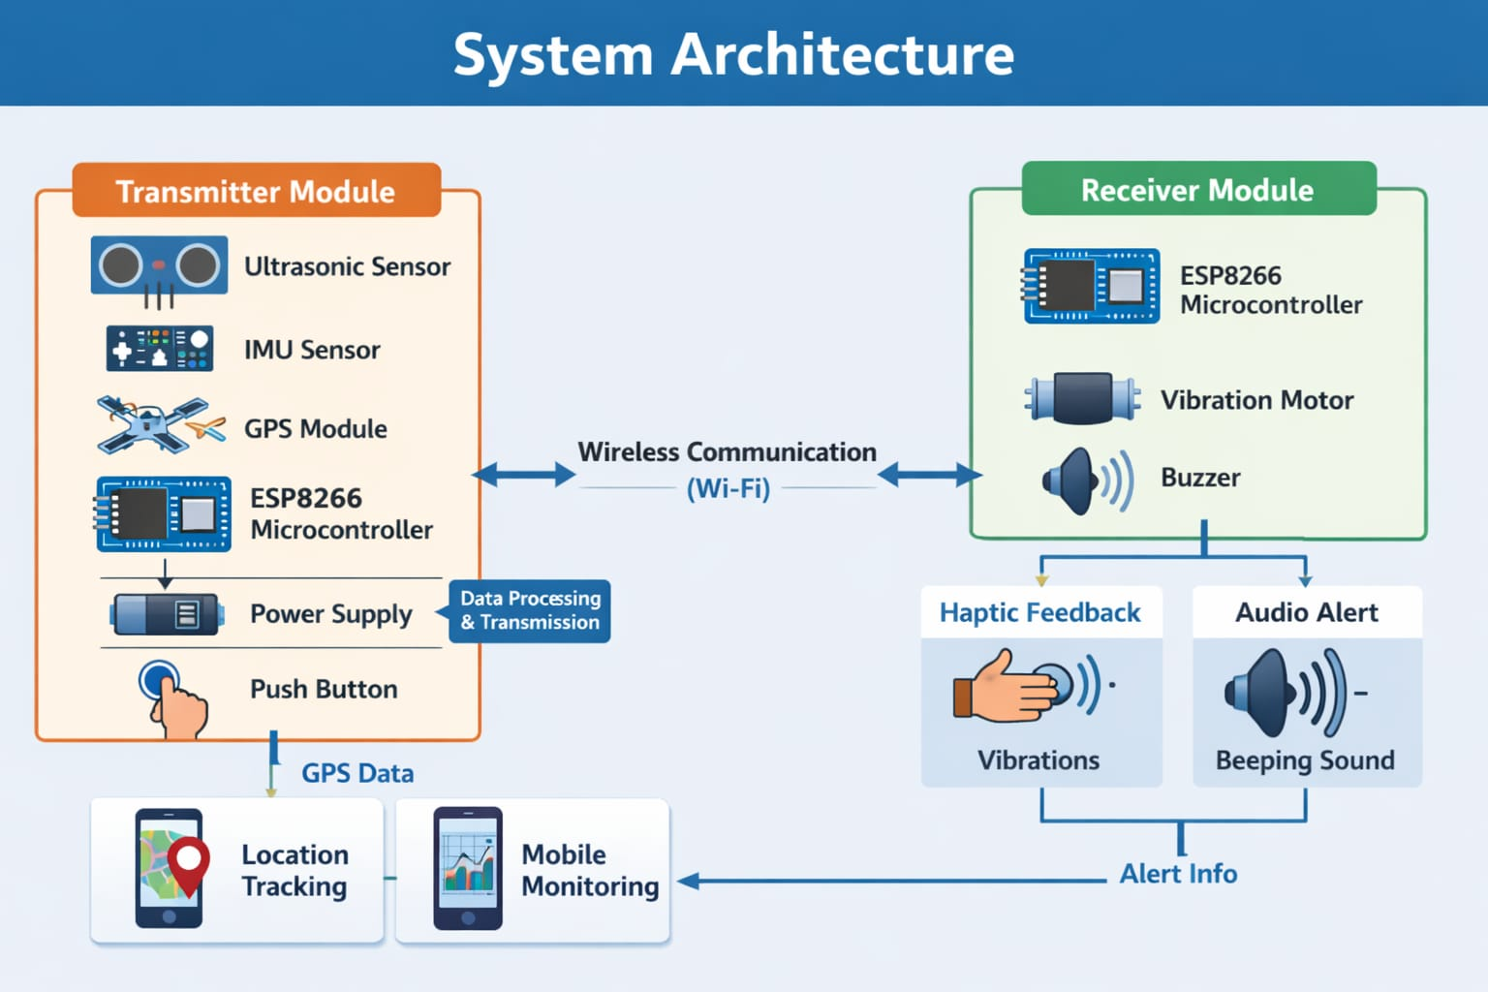
System architecture

Slide 11
Modules Used
Obstacle Detection Module – Uses an ultrasonic sensor to detect nearby obstacles and measure distance.
Wireless Communication Module – Enables data transfer between transmitter and receiver using ESP8266.
Location Tracking Module – GPS module provides the user’s location information.
Processing Module – The ESP8266 microcontroller processes sensor data and controls the system.
Alert Module – Vibration motor and buzzer provide vibration and sound alerts to the user.
User Input Module – Push button is used for manual input or emergency activation.

Slide 12
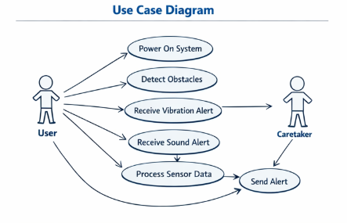

Slide 13
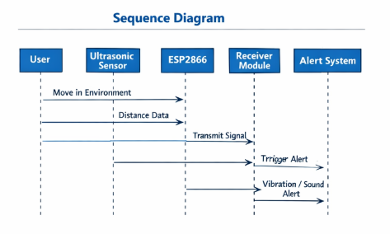

Slide 14
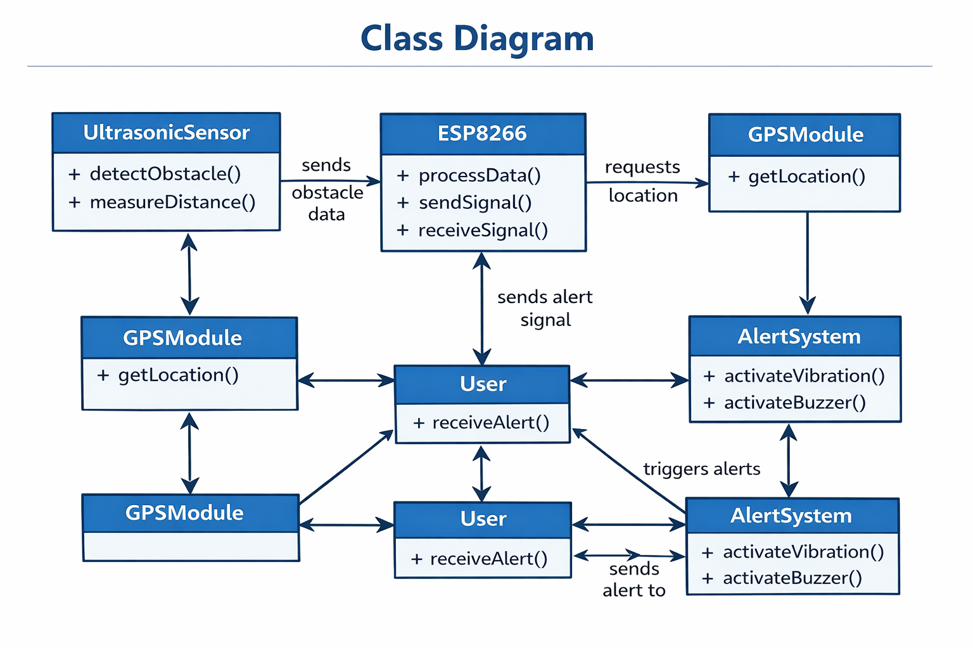

Slide 15
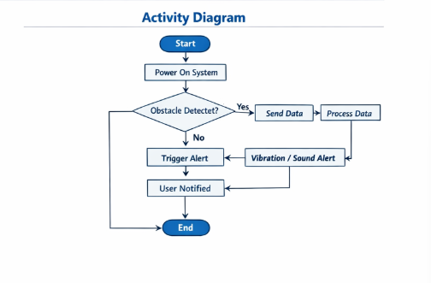

no

Slide 16
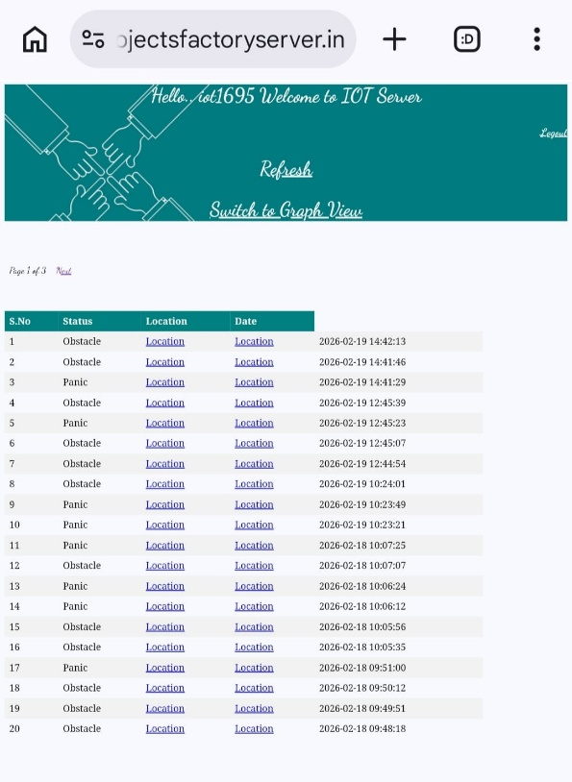
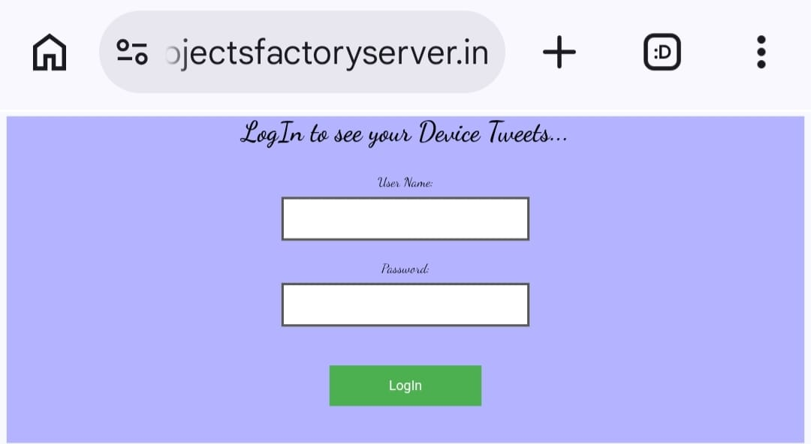
Results:

Slide 17
Conclusion:
The Haptic Interface System for Disabled Individuals was developed to assist visually impaired or disabled users in navigating their surroundings safely. The system uses sensors to detect obstacles and provides alerts through vibration and sound, allowing users to become aware of nearby objects without relying on vision.
The project successfully demonstrates how technologies such as the ESP8266 microcontroller, ultrasonic sensors, and GPS module can be integrated to create a useful assistive device. The system is cost-effective, portable, and capable of improving the independence and safety of disabled individuals during daily movement.

Slide 18
Future Enhancements
Integration with AI: Use machine learning for better obstacle recognition and decision-making.
Improved Sensors: Use advanced sensors (LiDAR/IR) for higher accuracy.
Mobile App Development: Develop a dedicated app for real-time monitoring and control.
Battery Optimization: Enhance power efficiency for longer usage.
Wearable Design: Convert the system into a compact wearable (belt/shoes/gloves).
Emergency Alert Feature: Send automatic alerts to caregivers during emergencies.
Cloud Connectivity: Store and analyze user data for improved performance.

Slide 19
References:
Human Haptic Perception, by Martin Grunwald, Birkhäuser Publishing, 2008.
Arduino IDE Documentation – https://www.arduino.cc/reference
ESP8266 Arduino Core Documentation – https://arduino-esp8266.readthedocs.io
ESP8266 Wi‑Fi Module Technical Datasheet – Espressif Systems.
HC‑SR04 Ultrasonic Sensor Datasheet – Distance Measuring Sensor Module.

Slide 20
Github link
https://github.com/abbu10101-design/HAPTIC-INTERFACE-SYSTEM-FOR-THE-DISABLED-INDIVIDUALS-

Slide 21
THANK
YOU

